Slide 1
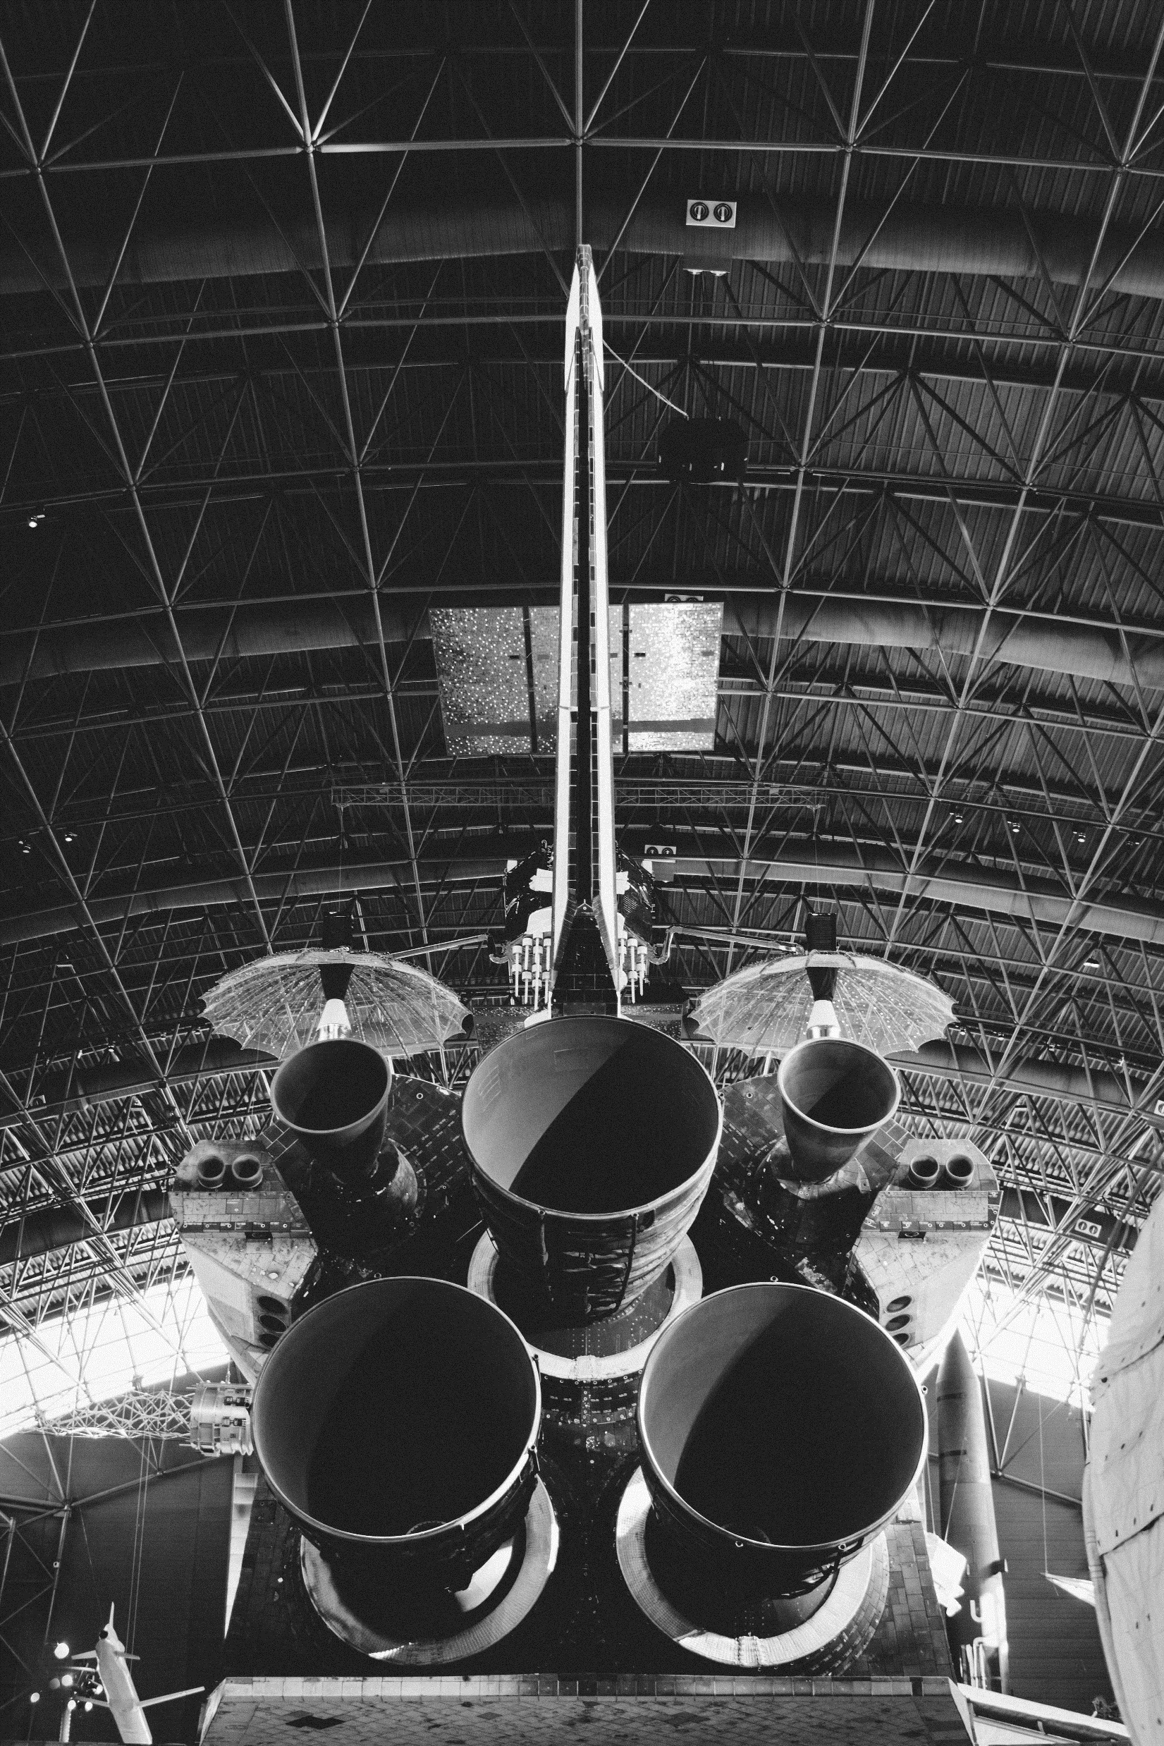
SPACE MISSIONS
An exploratory analysis on space missions embarked on by different countries between 1957 and 2022
Analyzed and Presented by: Daniel C. Akwason
Source of data: https://www.mavenanalytics.io/data-playground

Slide 2
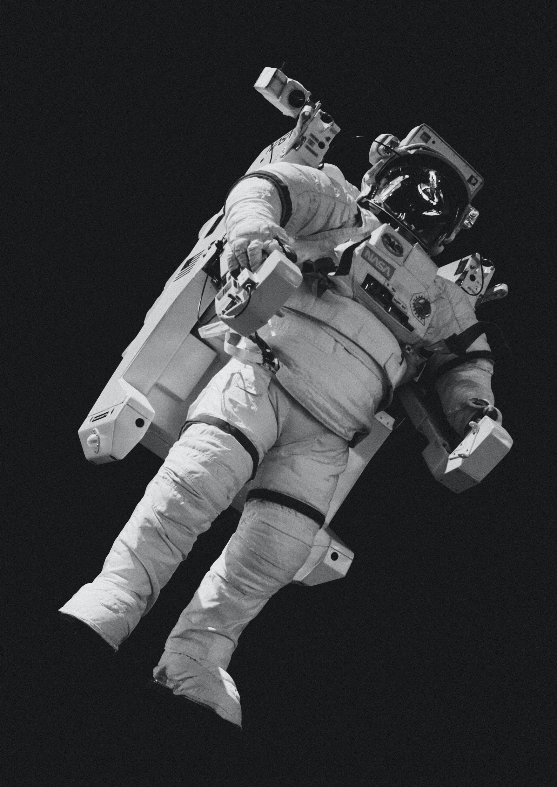
PROBLEM STATEMENTS
How have rocket launches trended across time? Has mission success rate increased?
Which countries have had the most successful space missions? Has it always been that way?
Which rocket has been used for the most space missions? Is it still active?

Slide 3



TOOLS AND DATA CLEANING PROCESS
STEP 1
STEP 2
STEP 3
IRRELEVANT DATA
DATA SPLITTING
DATA TRANSFORMATION
During my cleaning process I dropped the “Time” and “Price” columns from my dataset as they had blanks, invalid records, and would not be needed for my analysis.
I went on to use the Text split function to split both the “Location” and “Date” columns. I did this to create a column for country and year respectively.
After which, I replaced “Alaska” field with “USA” in the country column as it was a state in the USA. Five fields were affected in this transformation
Ready for Analysis
Tools used for this project
Microsoft Excel
Microsoft Power point
Tableau

Slide 4
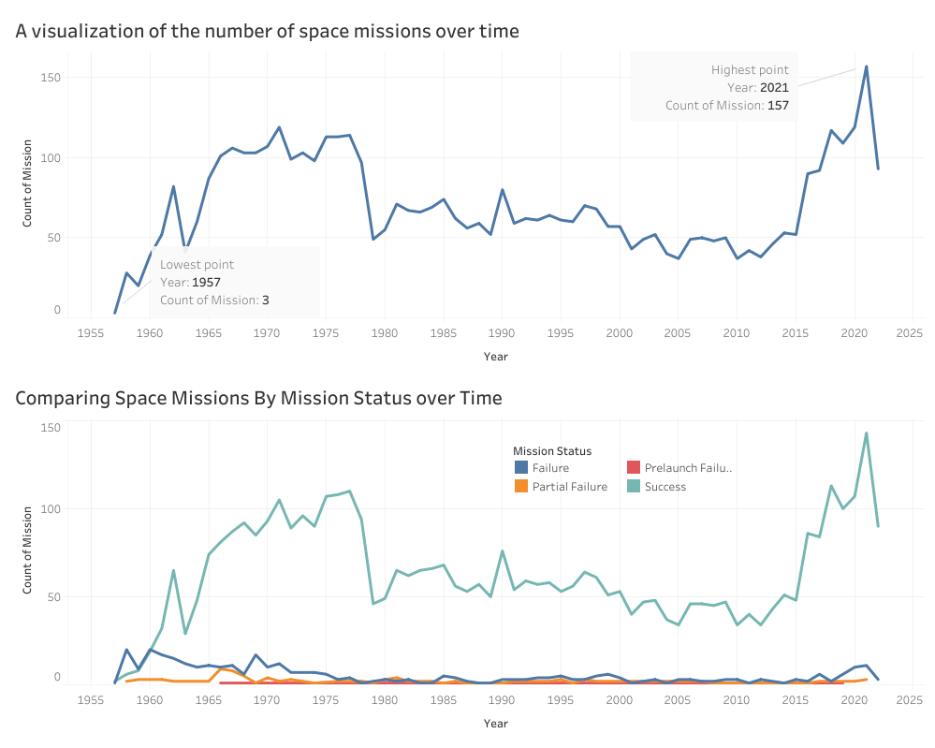
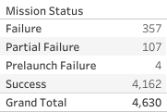
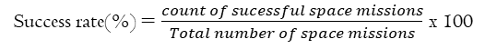
ANALYSIS
1
This visualization shows that between 1957 and 2022, the number of space mission increased significantly with its peak in 2021 having 157 space missions.
Also, the rate of our successful space missions is 89.89% which implies that we made a significant progress in 65 years.
Formulae
Success rate(%) $=\frac{count of sucessful space missions}{Total number of space missions}$ x 100

Slide 5
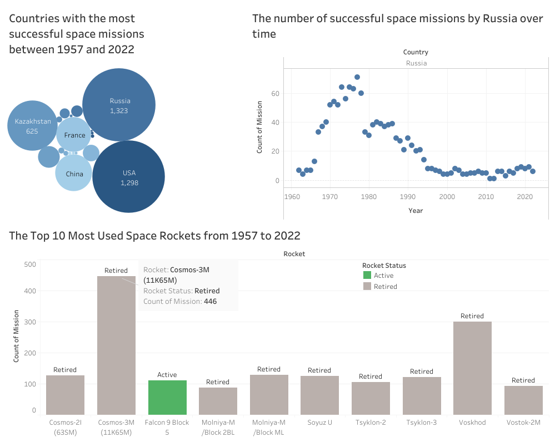
2
Russia is the country with the most successful space mission. However, a closer look at Russia successful space missions over time we could notice almost immediately that it has not always been that way. This could be due to the intensifying USSR war between 1980 to 1991 when the Soviet Union was dissolved.
3
The Russian Cosmos-3M(11k65M) is the most used space rocket with 446 space missions during active service. It is currently retired.

Slide 6
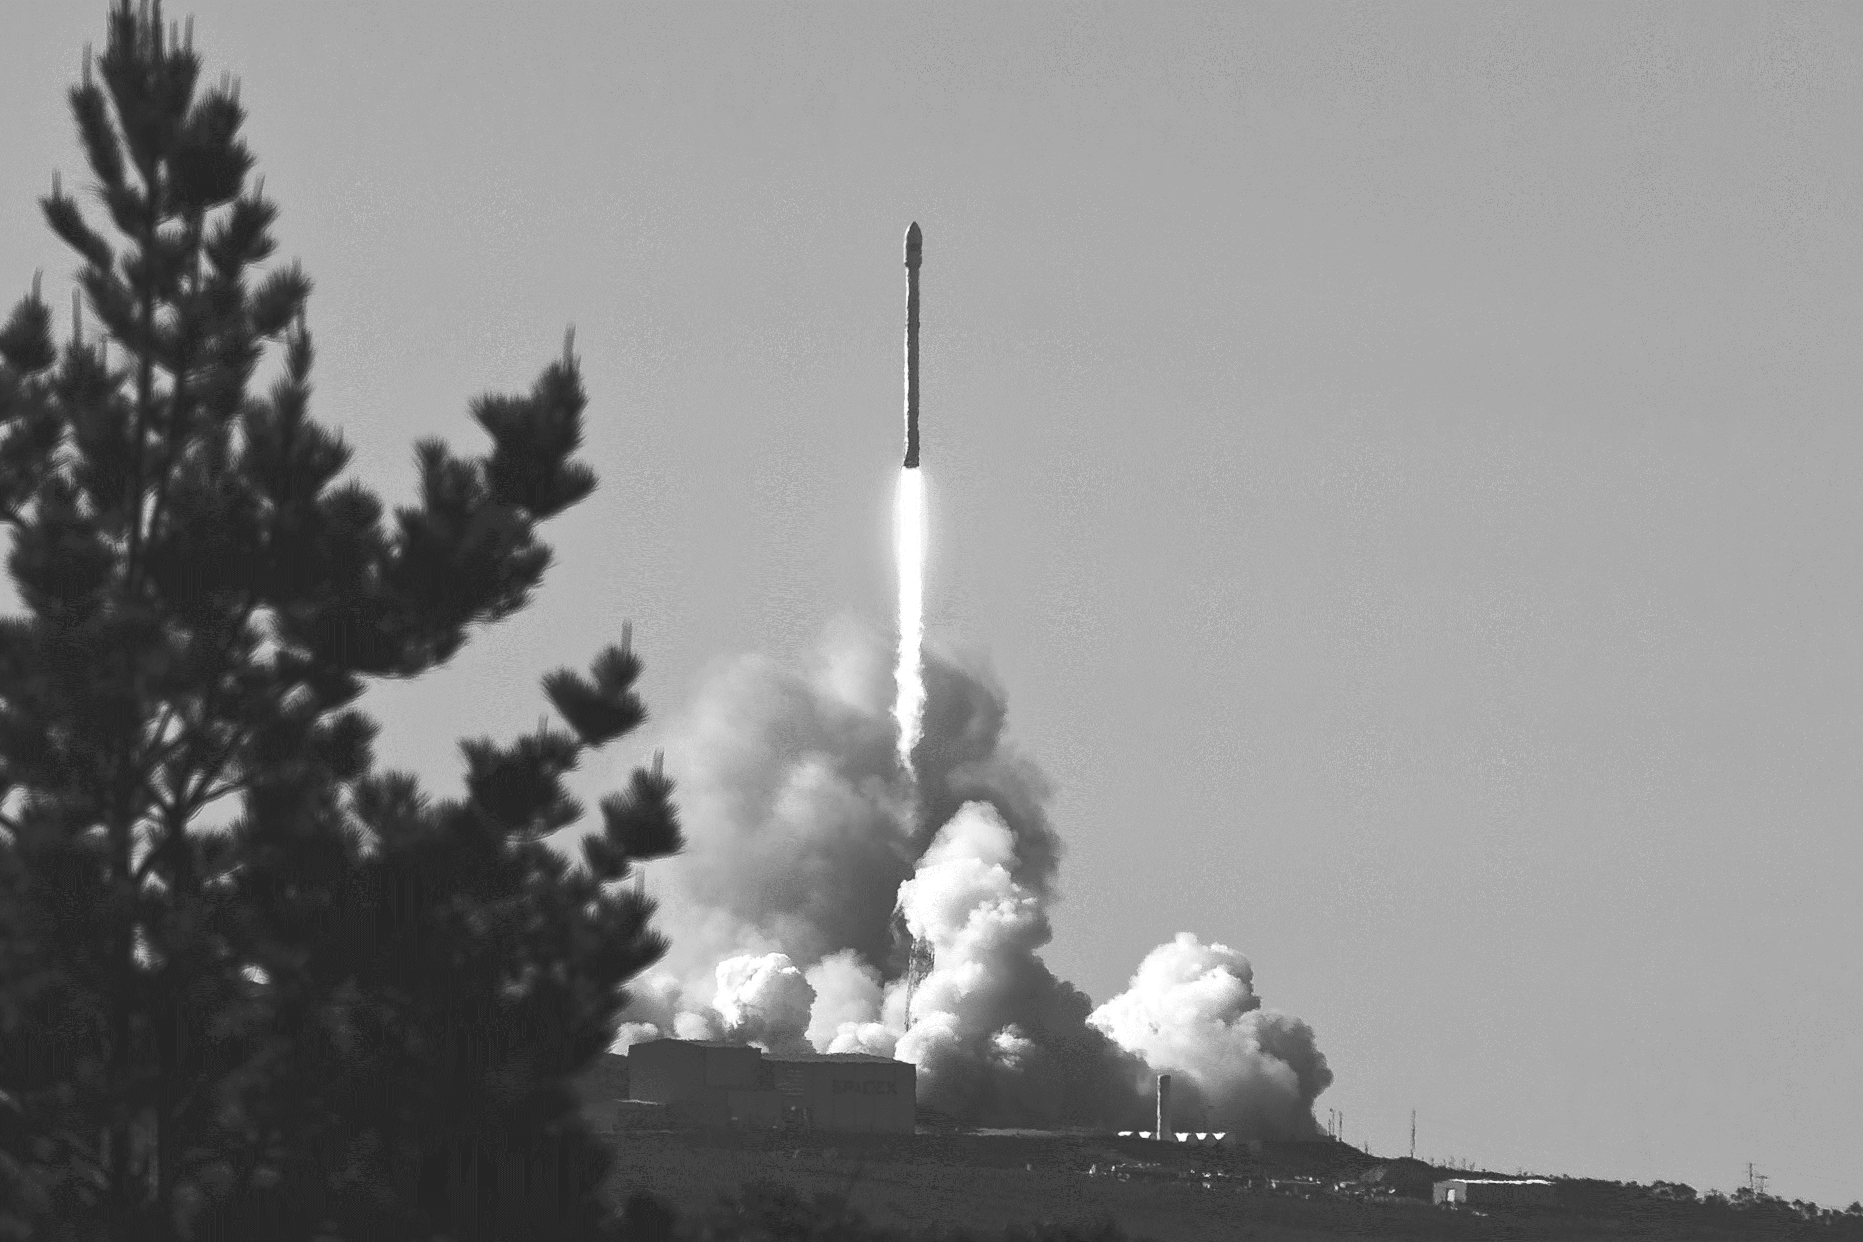
Thank you

